Slide 1
Agentic AI
Atul Kahate
https://www.linkedin.com/in/atulkahate/

Slide 2
Module 1: Agentic AI Fundamentals and LLM Access

Slide 3

AI Agent
AI Agent: It is a system that uses AI models to perform tasks
Can perceive its environment, make decisions, and take actions in order to achieve specific goals
Capability | Definition | Examples
Perception | Takes input from the environment | Camera images, text, audio, sensor data, user queries
Reasoning / Decision-making | Decides what to do using rules, logic, or machine learning | Choosing the best move in chess, planning a route, selecting a response
Action | Performs tasks based on decisions | Moving a robot arm, answering a question, executing a command
Learning (optional) | Improves performance over time using feedback | Updating chatbot responses, refining recommendations, improving accuracy

Slide 4
Real World Need of AI Agents
Scale: Too much data, too many decisions – Humans cannot do it
Bank frauds, Cloud server management
Speed: Decisions must be instant
Stock trading, Network intrusion detection
24x7 operation: Humans need breaks – systems do not
Customer support, System monitoring
Complexity: Too many variables
Supply chain, Smart grids
Adaptability: Changing environment
Recommendation systems, Cyber attacks
Autonomy: Reduce human dependence
Auto-healing of cloud infrastructure, Robotic Process Automation (RPA)
Decision support: Not just automation
Diagnostic agents for doctors, Investment agents for investment managers

Slide 5
Traditional, Generative, Agentic AI
Aspect | Traditional AI | Generative AI | Agentic AI
Core idea | Rules and prediction | Content generation | Autonomous goal execution
Main output | Labels / scores | New content | Actions and outcomes
Creativity | None | High | Moderate–High
Autonomy | Low | Low–Medium | High
Goal handling | Fixed objectives | Prompt-driven | Plans and sub-goals
Interaction | Predefined inputs | Prompts | Continuous loop
Tool usage | Minimal | When prompted | Self-selected and orchestrated
Memory | Minimal | Context-based | Short + long-term
Adaptability | Low | Medium | High
Human involvement | High | Medium | Low
Examples | Spam filter | ChatGPT | Auto-GPT / LangGraph
Use cases | Prediction | Content creation | Automation and decision-making

Slide 6
Agent Types
Reactive Agent: Sense -> Act (No planning)
Respond immediately to the current environment
No memory of past actions
No future planning
Rule-based bots, Simple if-else systems
Example: When an input file is received, process it and create a report
Proactive Agents: Goal-driven Behavior
Act to achieve specific goals
Can plan ahead
May consider future states
Planning agents, Goal-based decision systems
Example: A stock market agent that alerts you to sell a stock because price may fall
Autonomous Agents: Self-directed and Adaptive
Operate independently without constant human control
Learn from experience
Combine reactive + proactive behavior
Example: A research agent finds out the best sources of information, handles failures, and comes up with a report

Slide 7
Summary: Agent Types
Feature | Reactive | Proactive | Autonomous
Decision style | Immediate response | Goal-oriented | Self-directed
Planning | No | Yes | Yes
Learning | No | Sometimes | Yes
Human control | High | Medium | Low
Adaptability | Low | Medium | High

Slide 8

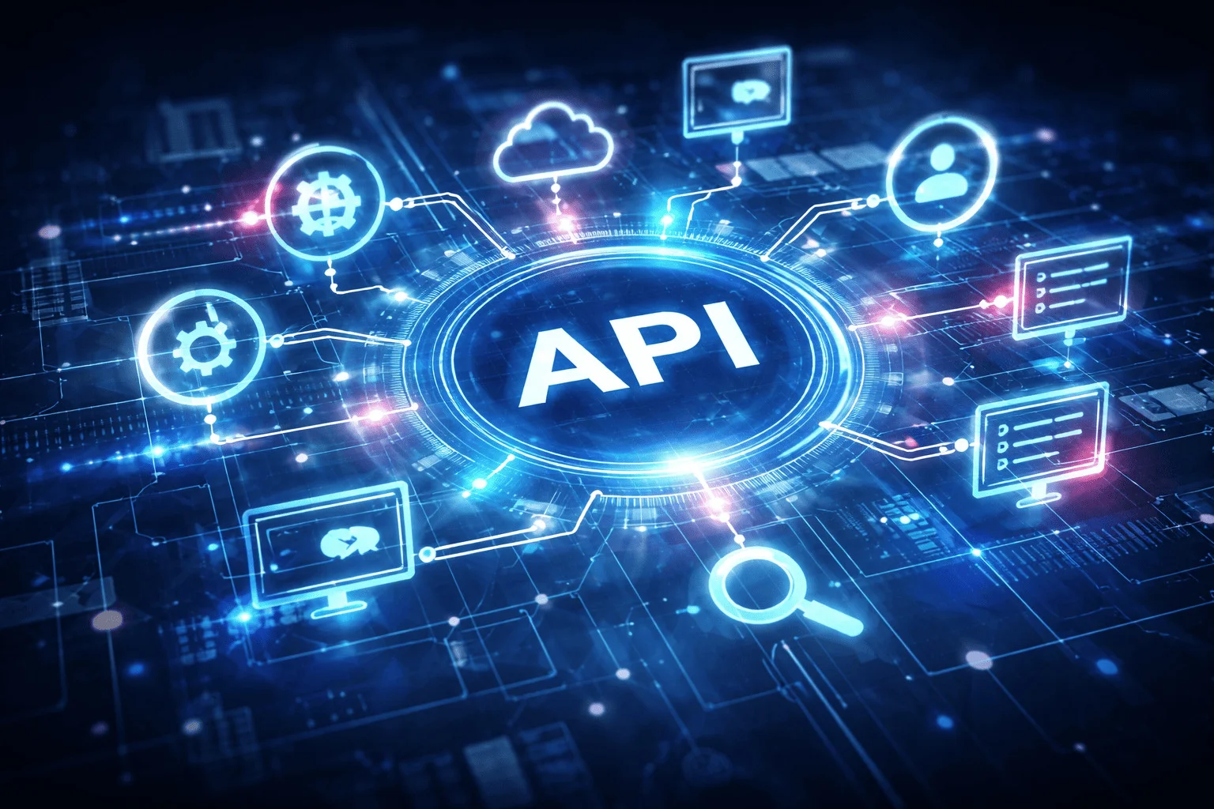



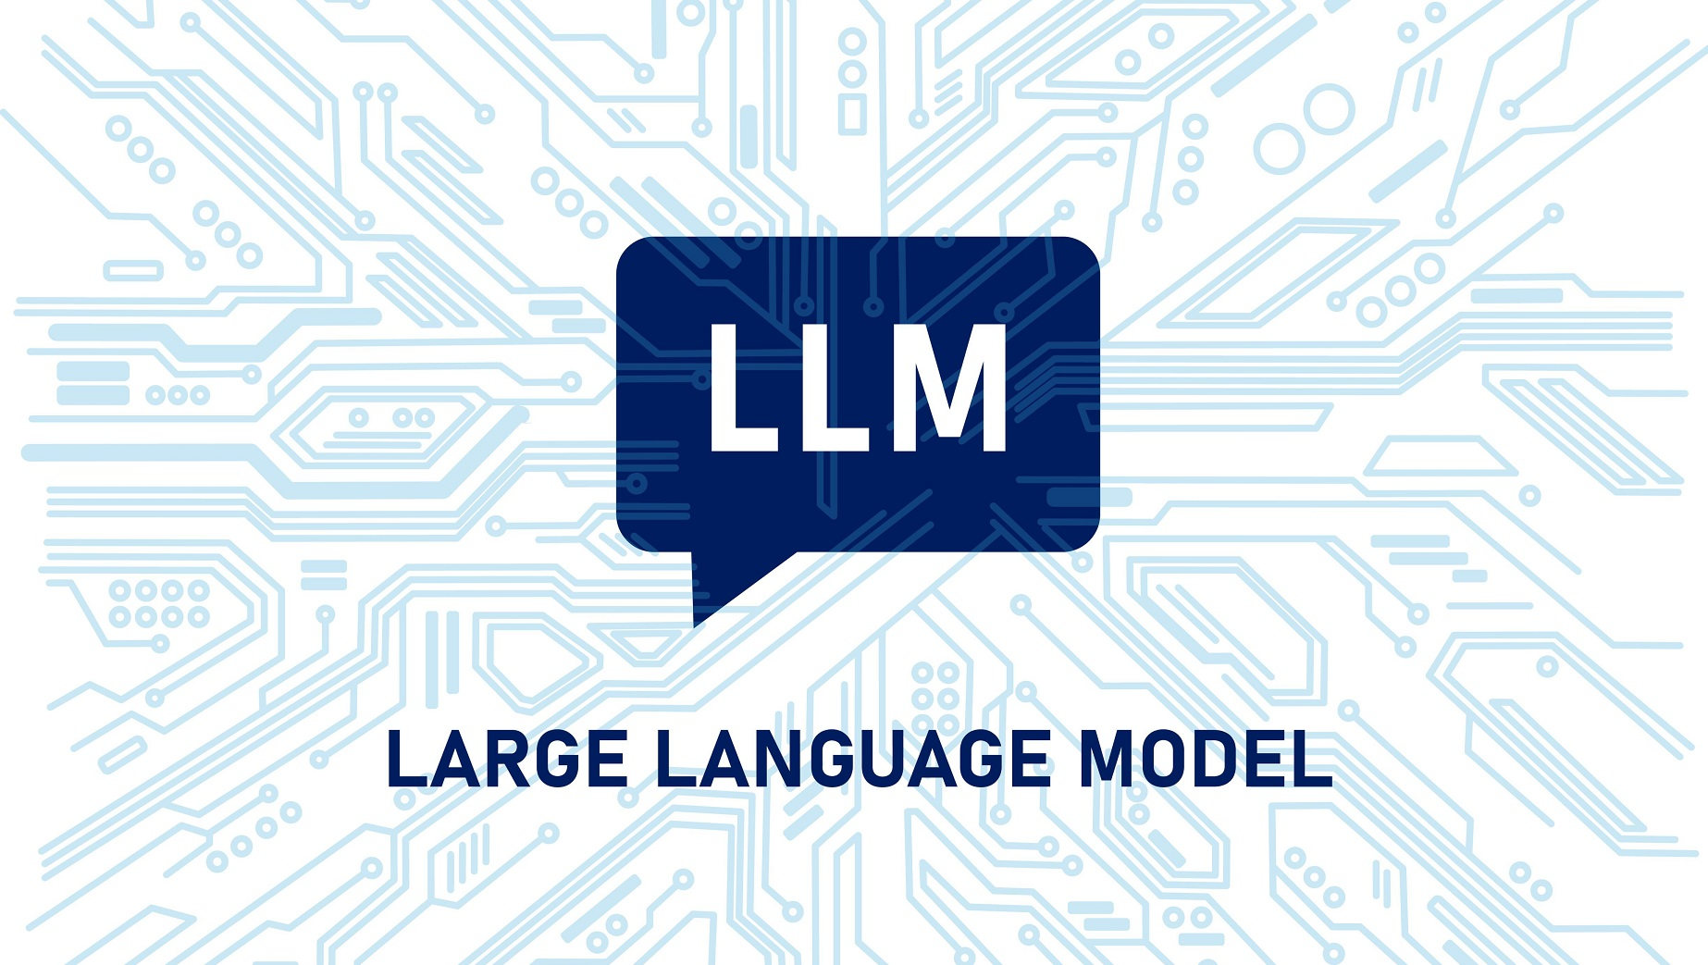
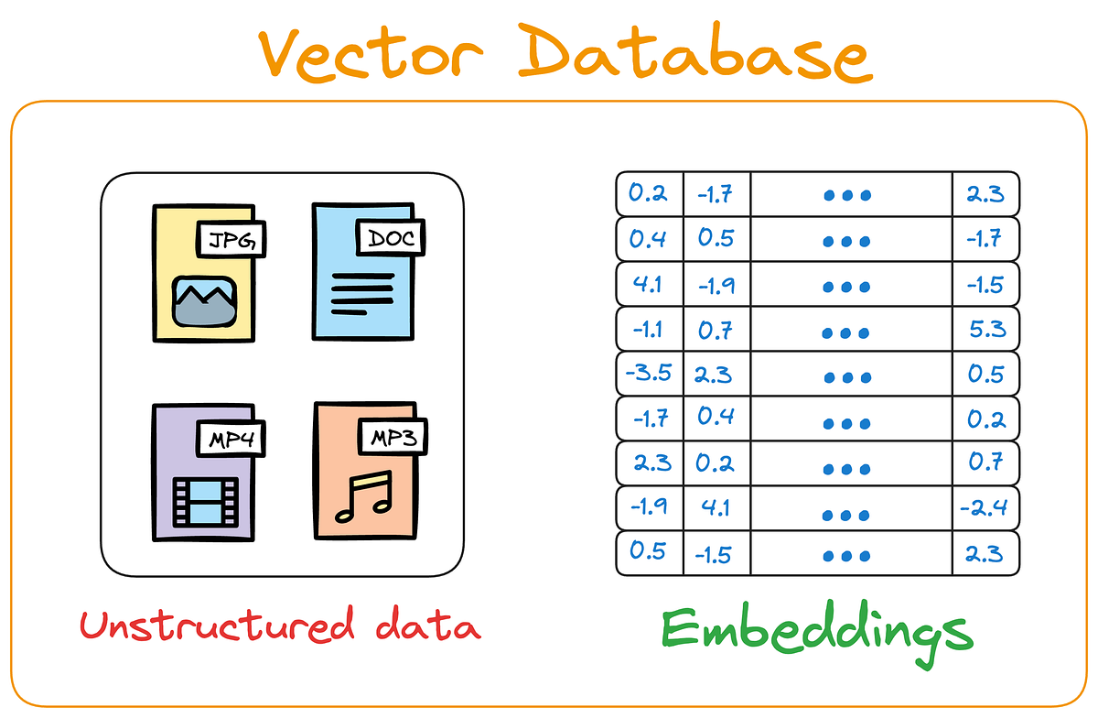

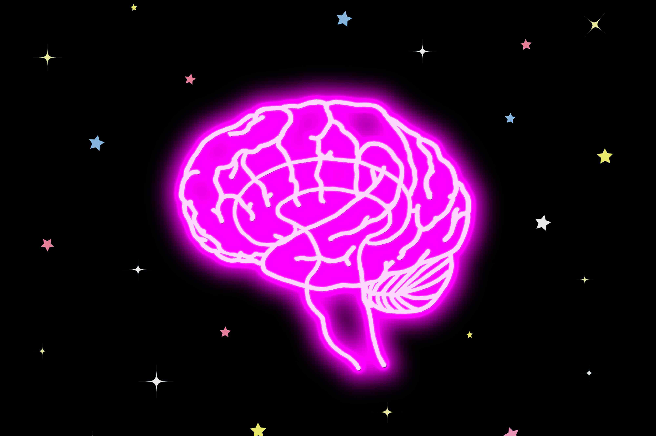

Foundational Components of an AI Agent
MCP
Instructions in a Natural Human Language
Think, Act, Review
Tool Calling
RAG
Guardrails
HITL
Memory
This Photo by Unknown Author is licensed under CC BY-ND

Slide 9
Industry Trends
General Trends (https://congruentx.com/emerging-trends-in-agentic-ai-for-2025)
Shift from Assistants to Autonomous Workflows (https://timesofindia.indiatimes.com/technology/tech-news/onix-2026-ai-trends-multi-agent-systems-redefine-enterprise-workflows/articleshow/126487254.cms)
Agentic Commerce Takes Off (https://www.investors.com/news/technology/shopify-stock-nrf-news-ai-agentic-shopping/)

Slide 10
Hands-on: Directly Accessing LLMs
Download and install Python Version 3.12 (https://www.python.org/downloads/)
Download and install VS Code (https://code.visualstudio.com/download)
Create a directory (e.g. c:\code\agenticai_realpage) on your machine
Set up Python in VS Code: Open VS Code and press Ctrl+Shift+P -> Python: Select interpreter -> Select Python that you have installed on your machine
Create a virtual environment in VS Code
Terminal -> New Terminal -> cd c:\code\agenticai_realpage
python -m venv myenv
myvenv\Scripts\activate (On Windows) and source myvenv/bin/activate (on Linux)
pip install openai openai-agents
Later to deactivate: deactivate

Slide 11
Using LLMs: OpenAI
Get an API key: https://platform.openai.com/settings/organization/api-keys
Copy it in .env file
pip install openai dotenv
Run C:\code\agenticai_realpage\module_1\1_openai_basic.py

Slide 12
Building the First Agent
Step 1: Setup and Imports
Code | Explanation
load_dotenv() | Loads API keys from .env file
OpenAI() | Instantiate an object of OpenAI class
from openai import OpenAI
from dotenv import load_dotenv
load_dotenv(override=True)
client = OpenAI()

Slide 13
Building the First Agent
Step 2: Call the LLM
Code | Explanation
create | Create a call to the LLM using the OpenAI Chat Completions API
model | Which LLM to use
messages | system: Set the persona user: A specific question/problem
response | What the LLM returns
response = client.chat.completions.create(
model="gpt-4o-mini",
messages=[
{"role": "system", "content": "You are a helpful assistant"},
{"role": "user", "content": "Explain agentic AI in one paragraph"}
]
)
print(response.choices[0].message.content)

Slide 14
Hugging Face
Open platform for AI model building, training, deployment
“GitHub of modern AI models”
Why Hugging Face?
Pretrained models – No need to train from scratch
Standardized APIs – Faster experimentation
Open ecosystem – Models, Datasets, Demos, Tools
Core components
Component | Purpose
Transformers | State-of-the-art models (BERT, GPT, T5, LLaMA, etc.)
Datasets | Ready-to-use datasets with versioning
Inference API | Run models without infrastructure
Spaces | Share ML demos (Gradio / Streamlit)
Hub | GitHub-like repo for models & datasets

Slide 15
Hugging Face
Typical workflow
Choose a pretrained model from the Hub
Load it using Transformers
(Optional) Fine-tune on your data
Deploy via API / local / cloud

Slide 16
Using LLMs: Hugging Face
Open-source models
We have full control
Offline / On-prem
No vendor lock-in
Very slow, sometimes
Two options
Transformers API (Local/GPU/CPU): pip install transformers torch accelerate
We download and run the model inside our environment
Hugging Face Interface API (Hosted): pip install huggingface_hub
Model runs on Hugging Face cloud infrastructure
Code: module_1\2_hugging_face_local.py
Will not run, unless we make a payment on Hugging Face site to enable inference endpoints (endpoints.huggingface.co)

Slide 17
Creating a Simple Utility Agent Using OpenAI API (No Frameworks)

Slide 18
Building a Multi-Assistant Agent Step-by-Step
Step 1: Setup and Imports
import asyncio
from agents import Agent, Runner, function_tool
from datetime import datetime
from dotenv import load_dotenv
load_dotenv(override=True)
Code | Explanation
agents | OpenAI Agents SDK
asyncio | For running multiple queries concurrently
function_tool | Decorator to convert functions into agent tools
load_dotenv() | Loads API keys from .env file
Installations
pip install openai-agents dotenv

Slide 19
Building a Multi-Assistant Agent Step-by-Step
Step 2: Create Tools
@function_tool
def get_temperature(city: str) -> str:
"""Returns mock temperature for a city."""
temps = {
"new york": "72°F",
"london": "65°F",
"tokyo": "78°F",
"sydney": "68°F",
"mumbai": "85°F"
}
return temps.get(city.lower(), "70°F")
Code | Explanation
@function_tool | Decorator tells the agent that it is a callable tool
“”” … ‘’’ | Docstring helps the agent decide if and when to use this tool

Slide 20
Building a Multi-Assistant Agent Step-by-Step
Step 2: Create Tools
@function_tool
def get_time(timezone: str) -> str:
"""Returns current time for a timezone."""
return datetime.now().strftime("%I:%M %p")
@function_tool
def calculate(expression: str) -> str:
"""Evaluates a simple math expression."""
try:
result = eval(expression)
return f"{expression} = {result}"
except:
return "Invalid expression"

Slide 21
Building a Multi-Assistant Agent Step-by-Step
Step 3: Create Agent
agent = Agent(
name="QuickAssistant",
model="gpt-4o-mini",
tools=[get_temperature, get_time, calculate],
instructions="You are a helpful assistant. Use tools when needed. Be concise."
)
Code | Explanation
name | Identifies the agent
model | Which LLM to use?
tools | List of available tools
instructions | System prompt

Slide 22
Building a Multi-Assistant Agent Step-by-Step
Step 4: Prepare Test Queries
async def run_agent():
queries = [
"What's the temperature in Tokyo?",
"Calculate 25 * 4 + 10",
"What time is it in New York timezone?",
]
print("Processing queries in parallel...\n")
Code | Explanation
queries | List of queries to be sent to the agent
async def | Run this concurrently
Queries are in natural (human) language
Agent will figure out if and which tool to call

Slide 23
Building a Multi-Assistant Agent Step-by-Step
Step 5: Run Queries Concurrently
# Process all queries concurrently
tasks = [Runner.run(agent, query) for query in queries]
results = await asyncio.gather(*tasks)
Code | Explanation
Runner.run(agent, query) | Executes agent with a query, [ ] creates a list comprehension, i.e. multiple tasks
asyncio.gather() | Runs all tasks simultaneously and waits for all to complete
await | Waits for all results before continuing

Slide 24
Building a Multi-Assistant Agent Step-by-Step
Step 6: Display Results
# Display results
for query, result in zip(queries, results):
print(f"Q: {query}")
print(f"A: {result.final_output}\n")
Code | Explanation
zip() | Pairs each query with its result
result.final_output | Agent’s final answer, after all tool calls

Slide 25
Building a Mult-Assistant Agent Step-by-Step
Step 7: Run the Program
if __name__ == "__main__":
asyncio.run(run_agent())
Code | Explanation
if __name__ == “__main__”: | Standard Python syntax – Only runs if the file is executing directly
asyncio.run() | Starts the async event loop and runs main()

Slide 26
asyncio in Python
Normally, Python runs code synchronously (line by line) - If one line is slow (e.g., waiting for a network request), everything else is stuck
But with asyncio, we can do something else while waiting
Analogy:
Normal code (sync): We are cooking noodles. We boil water, stand still until it boils, then add noodles.
Async code: While waiting for the water to boil, we cut vegetables and prepare sauce. Nothing is wasted.
Code example: Next slide

Slide 27
asyncio Code Example
import asyncio
async def task(name, delay):
print(f"Task {name} started")
await asyncio.sleep(delay) # simulate waiting
print(f"Task {name} finished after {delay} seconds")
async def main():
# Run tasks concurrently
await asyncio.gather(
task("A", 2),
task("B", 1),
task("C", 3),
)
asyncio.run(main())
How to write
Coroutine: A special function defined with async def, which can be paused (await) and resumed later
Event loop: The core of asyncio, which manages all coroutines and usually starts with asyncio.run(function())
await: Used inside asyncio def functions to wait for another coroutine … While waiting, Python can run other tasks

Slide 28
Module 2: LangChain

Slide 29
LangChain
LangChain: A framework for building applications powered by Large Language Models (LLMs) by connecting them with external data, tools, and workflows
Features
Load data from different sources
Reason over that data using LLMs
Build reliable, production-ready AI systems

Slide 30
Evolution of Approaches to Work with LLMs
Aspect | OOP-style (Manual) | LangChain (LCEL) | LangGraph
Core idea | Traditional Python classes/functions controlling API calls | Functional and declarative LLM “chains” using the LangChain Expression Language (LCEL) | Graph-based, event-driven system where each node can be an LLM, tool, or function
Level of abstraction | Low — direct API calls and manual flow | Medium — declarative pipeline of components | High — nodes and edges define complex, reactive workflows
State management | Manual; handled in code (variables, memory) | Partly handled via memory components or retrievers | Explicit and persistent graph state (supports branches, loops, conditional edges)
Error handling / control flow | Manual try/except logic | Built-in retry and fallback options | Graph nodes can define error edges or conditional transitions
Reactivity / branching | Linear; must code logic explicitly | Mostly linear (LCEL adds limited conditional logic) | Fully reactive — conditional routing, parallel branches, feedback loops
Use case fit | Simple, one-off LLM calls or prototypes | Standard pipelines (e.g., prompt → LLM → parser → tool) | Complex, multi-agent, or stateful reasoning workflows
Example use case | “Ask LLM to summarize text” | Same, but wrapped in a LangChain chain | Same, but modeled as a small reactive graph

Slide 31
Comparison of the Approaches
Object-Oriented
LangChain
LangGraph
from langchain_openai import ChatOpenAI
from langchain.prompts import PromptTemplate
from langchain.schema.runnable import RunnableMap, RunnablePassthrough
llm = ChatOpenAI(model="gpt-4o-mini")
prompt = PromptTemplate.from_template("Summarize this: {text}")
chain = {"text": RunnablePassthrough()} | prompt | llm
result = chain.invoke({"text": "LangChain and LangGraph simplify how developers use LLMs."})
print(result.content)
from langgraph.graph import Graph, END
from langchain_openai import ChatOpenAI
llm = ChatOpenAI(model="gpt-4o-mini")
# Define the node (a summarization step)
def summarize_node(state):
text = state["text"]
prompt = f"Summarize this: {text}"
result = llm.invoke(prompt)
return {"summary": result.content}
# Build graph
graph = Graph()
graph.add_node("summarize", summarize_node)
graph.set_entry_point("summarize")
graph.add_edge("summarize", END)
# Run
result = graph.invoke({"text": "LangChain and LangGraph simplify how developers use LLMs."})
print(result["summary"])
from openai import OpenAI
client = OpenAI()
text = "LangChain and LangGraph simplify how developers use LLMs."
prompt = f"Summarize this: {text}"
response = client.chat.completions.create(
model="gpt-4o-mini",
messages=[{"role": "user", "content": prompt}]
)
print(response.choices[0].message.content)

Slide 32
LangChain and LangGraph
LangChain: Framework to use LLMs as AI agents with access to external tools (APIs, databases, etc)
Works well for single-step or simple request-response workflows
Not ideal for complex, multi-step, stateful workflows involving multiple agents or actors interacting over time
Solution: LangGraph
LangGraph: Designed for stateful, multi-actor applications with LLMs
Allows building complex workflows where multiple agents collaborate, maintain memory, and handle dynamic execution

Slide 33
Code Examples (C:\code\agenticai_realpage\module_2)
Sr No | File | Purpose
1 | 2_langchain_1_calculator_ollama.py | Basic calculator using Ollama
2 | 2_langchain_1_calculator_openai.py | Same example using OpenAI
3 | 2_langchain_2_tavily_search_tool.py | Using Agent primitive, Tool (Tavily search)

Slide 34
Loaders in LangChain
Loaders: Components that read data from a source and convert it into Documents that LLMs can understand
PDFs, Word documents, Website data, Databases are loaded into a standard format
Document(
page_content="text",
metadata={...}
)
Popular built-in loaders: TextLoader, PyPDFLoader, CSVLoader, etc
Code: module_2\2_langchain_load_pdf.py

Slide 35
LangChain Embeddings – RAG and Vector Databases

Slide 36
What is RAG?
Concept | Explanation
Frozen Knowledge | LLMs are trained to have knowledge up to a specific date
Hallucination | A situation where a generative AI model (LLM) does not know the correct answer and produces incorrect, made-up, or nonsensical information
Why? | LLMs cannot answer questions about information they were not trained on or that is missing/incorrect in their training data
Why RAG? | RAG provides external, up-to-date, factual information to the LLM so it can answer accurately “RAG starts where generative AI ends”
RAG Parts | Retriever: Fetches relevant documents from external sources (e.g., Pinecone, Chroma, LlamaIndex, Activeloop) Generator: The LLM that uses the retrieved context to generate accurate answers

Slide 37
Agentic RAG
Aspect | Traditional RAG | Agentic RAG
Core idea | Retrieve then generate | Agent decides how and when to retrieve
Control flow | Fixed pipeline | Dynamic, decision-driven
Retrieval steps | Single retrieval | Multiple, iterative retrievals
Reasoning | Minimal | Explicit reasoning and planning
Autonomy | Low | High
Tool usage | Retriever only | Retriever + tools
Memory | Limited context | Short-term and long-term memory
Error handling | None | Reflection and self-correction
Query refinement | Manual | Automatic
Multi-source retrieval | Limited | Supported
Example | FAQ chatbot | Research assistant agent

Slide 38
Embedding and Vector
Embedding: A technique to represent information (text, image, audio, video) as a list of numbers such that similar items have vectors that are close to each other in high-dimensional space
How? Convert information (text, image, audio, video) into a vector (list of numbers)
Example
Original text: “Cute dog”
Embedding: [0.02134, -0.00312, 0.01579, 0.09821, -0.04412, …]
The entire vector captures semantic meaning in a compressed way, i.e. individual numbers are not interpretable
Distances between embeddings reflect similarity
One Embedding = One Vector
How similar are two vectors? (1) Cosine Similarity, (2) Euclidean Distance

Slide 39
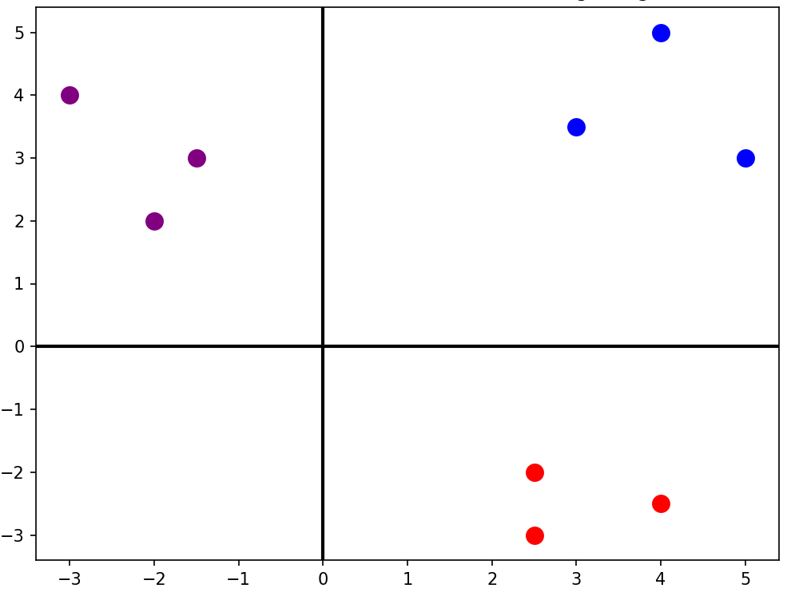
2D Vector Embeddings Example
king [4 5]
man [3 3.5]
woman [5 3]
apple [2.5 -2]
banana [2.5 -3]
orange [4 -2.5]
football [-3 4]
golf [-1.5 3]
tennis [-2 2]

Slide 40
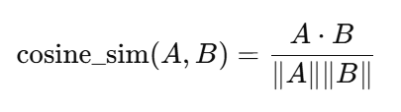
Cosine Similarity
Imagine two arrows starting from the same point
Cosine similarity: Measures how aligned two vectors are, not how far apart they are
Answers questions: Do these vectors point in the same semantic direction?
Vector Direction Relationship | Intuitive Meaning | Angle Between Vectors | Cosine Value
Pointing in the same direction | Very similar | 0° | 1
Pointing at right angles | Unrelated / Orthogonal | 90° | 0
Pointing in opposite directions | Opposites | 180° | −1

Slide 41
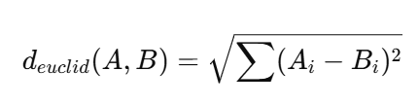
Euclidean Distance
Think of vectors as points
Euclidean distance measures
Physical distance
Geometric closeness
Works exactly like measuring distance in a map
Less distance = More similar
Feature | Euclidean Distance | Cosine Similarity
Measures | Straight-line distance | Angle between vectors
Sensitive to magnitude | Yes | No
Semantic similarity | Sometimes | Best
Used in NLP search | Rarely | Common

Slide 42
Why Cosine Similarity is Better in NLP?
In NLP, we care about meaning direction, not sentence size
Step | Details
1) What Embedding actually is | An NLP embedding vector model contains: Direction = Meaning Length (Magnitude) = How much information / How verbose Think of vectors like arrows: Same direction = Same meaning Longer arrow = More words / emphasis / details
2) What Euclidean Distance actually measures | Euclidean Distance answers: How far apart are the arrow tips Summary: It cares about length and absolute path, not direction Problem for NLP: Two sentences with the same meaning but different lengths end up far apart
3) NLP Example | Sentence A (Short): Apply for Loan Sentence B (Long): I would like to apply for a personal loan as soon as possible Result: Euclidean Distance between them is large, so the model thinks they are “different”, which is a mistake

Slide 43
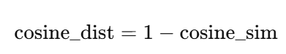
Euclidean Distance vs Cosine Distance
Basic difference: Magnitude versus Direction
Metric | What it measures
Euclidean distance | How far apart two vectors are in space
Cosine distance | How different their directions (angles) are
Vector DB | Default
Chroma | Cosine
FAISS (NLP) | Cosine / Inner Product
Pinecone | Cosine
Weaviate | Cosine
OpenAI embeddings | Cosine
Same direction, different length
A = (10, 10)
B = (1, 1)
Cosine similarity ≈ 1.0 (same meaning)
Euclidean distance = large
Different direction, same length
A = (10, 0)
B = (0, 10)
Cosine similarity = 0
Euclidean distance = same as earlier case

Slide 44
Code Examples
Basics of Cosine Similarity and Euclidean Distance -> C:\code\agenticai_realpage\module_2\2_langchain_basic_rag_cosine_euclidean_1.py
Why Cosine Similarity is better ->
C:\code\agenticai_realpage\module_2\2_langchain_basic_rag_cosine_euclidean_1.py

Slide 45
Embedding Models
Model Name | Provider | Key Features (Simple Words) | Typical Dimensions
text-embedding-3-small | OpenAI | Fast, cheap, good for search and clustering | 1536
text-embedding-3-large | OpenAI | Highest accuracy, best semantic understanding | 3072
all-MiniLM-L6-v2 | Hugging Face / Sentence Transformers | Very fast, small, good for local use; widely used | 384
all-mpnet-base-v2 | Hugging Face / Sentence Transformers | High quality semantic search; great balance of speed + accuracy | 768
bge-small-en | Hugging Face (BAAI) | Very fast, optimized for retrieval tasks | 384
bge-base-en | Hugging Face (BAAI) | Strong semantic retrieval; good general-purpose model | 768
bge-large-en | Hugging Face (BAAI) | Very high accuracy; heavier to run | 1024
e5-small-v2 | Hugging Face (Microsoft) | Lightweight; very good for embeddings in search tasks | 384
e5-base-v2 | Hugging Face (Microsoft) | Strong performance for retrieval, question–answering | 768
instructor-xl | Hugging Face (HKU + Meta) | Instruction-based embeddings (you can tell the model what to focus on) | 768 / 1024+
Concept | Meaning | Example
Embedding Model | An AI model that creates these vectors | OpenAI “text-embedding-3-small”
Dimension | How many numbers are in each vector | 1536 numbers, 3072 numbers, etc.
Similarity | How close two vectors are in meaning | “cat” vector ≈ “kitten” vector
Distance | Mathematical gap between two vectors | Small distance → similar meaning
Vector Space | The “map” where all vectors live | Similar ideas group together in space
Use Cases | What embeddings are used for | Search, recommendations, clustering
“Cute dog”
Embedding model
[0.02134, -0.00312, 0.01579, …]

Slide 46
Vector Databases
Vector DB | Type | Best For | Pros | Cons
ChromaDB | Local / Embedded | Small–medium apps, notebooks, prototyping | Easy to use, local persistence, Python-friendly | Not ideal for very large scale
FAISS | Library (not a DB) | Fast similarity search inside apps | Very fast, offline, highly optimized | No metadata store, no server mode
Pinecone | Fully-Managed Cloud | Production-grade large-scale search | Scalable, high availability, no infra needed | Paid, cloud-only
Weaviate | Open-source + Cloud | Semantic search with metadata | Hybrid search, schema, GraphQL API | More complex setup
Milvus | Open-source + Cloud | Heavy workloads, millions of vectors | Highly scalable, rich index options | Requires infrastructure management
Qdrant | Open-source + Cloud | Production apps with filters | Fast, good filtering, simple API | Slightly heavier setup locally
Redis Vector Store | Add-on to Redis | Apps already using Redis | Fast, real-time similarity | Requires Redis, not specialized

Slide 47
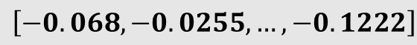
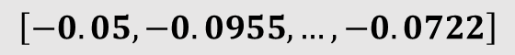

Vector Database (Code: C:\code\agenticai_realpage\module_2\2_langchain_vector_db_chroma.py )
Vector database
Embedding
$$\left[−0.05, −0.0955, …, −0.0722\right]$$
Embedding
$$\left[−0.068, −0.0255, …, −0.1222\right]$$
. . .
. . .
Embedding
$$\left[−0.023, −0.0412, …, −0.0003\right]$$
Text splits

Slide 48
Chains
Chain: Sequence of calls to components
In the early days of LangChain, these were "pre-built" classes (like RetrievalQA), but modern LangChain uses a more flexible approach
Take an Input (User Question) → process it (Retrieval) → pass it to a Prompt → send it to an LLM → get an Output
Legacy vs. Modern: While "Chains" is the general term for the workflow, most developers have moved toward LCEL (LangChain Expression Language) for better control
Example
chain = prompt | model | output_parser
response = chain.invoke({"topic": "black holes"})

Slide 49
LCEL
LangChain Expression Language (LCEL): Modern, declarative way to build and customize chains in LangChain
Replaces the older, "hidden" logic of legacy classes like LLMChain or RetrievalQA
Treats every component (prompts, models, retrievers, parsers) as a "Runnable" that can be snapped together

Slide 50
Runnables and LCEL
Runnables: Building blocks of the LangChain Expression Language (LCEL)
"Runnable" is a standard interface that allows us to "pipe" components together using the | operator
Pipe Operator (|): Behaves like a Unix pipe and takes the output of the left side and feeds it as the input to the right side
Why use it? It automatically handles things like:
Async: Running tasks in the background
Batch: Processing multiple inputs at once
Streaming: Seeing the AI's response character by character
Code: module_2\2_langchain_lcel_runnable.py, module_2\2_langchain_multiple_streaming.py

Slide 51
LangServe
LangServe: Official way to turn our LangChain runnables and chains into a REST API
Built on top of FastAPI
Automatically handles the complex parts of deployment, like schema validation, multiple endpoints (/invoke, /batch, /stream), and even a built-in interactive playground
We register our LangChain code and register with a path – LangServe creates
API endpoints
Schema (Automatic JSON validation using Pydantic)
Playground to test the chain

Slide 52
LangServe: How to Use?
Create deployment code and run it: C:\code\agenticai_realpage\module_2\2_langchain_server.py
To test, browser: http://localhost:8000/note/playground/
Through code: C:\code\agenticai_realpage\module_2\2_langchain_test_server.py
To run, Terminal -> New Terminal Window and then run it

Slide 53
Build a Q&A Bot from PDFs
Chroma DB, Insurance example: C:\code\agenticai_realpage\module_2\2_langchain_qand_a_bot_chroma.py
Test: Browser - http://localhost:8000/ask/playground/
FAISS: C:\code\agenticai_realpage\module_2\2_langchain_qanda_bot_faiss.py
Test: Browser - http://localhost:8000/ask/playground/
While Chroma manages a directory of files automatically, FAISS typically saves to a single .index file along with a .pkl for the documents
In LangChain, we use save_local and load_local for this

Slide 54
Chroma Versus FAISS
Aspect | Chroma code | FAISS code
What we are using | langchain_chroma.Chroma | langchain_community.vectorstores.FAISS
Installation | pip install chromadb | pip install faiss-cpu
Storage type | Embedded DB (DuckDB + files) | Index + pickle files
Persistence logic | Automatic | Manual
Persistence code | persist_directory=PERSIST_PATH | vector_db.save_local(PERSIST_PATH)
Load logic | Chroma(persist_directory=..., embedding_function=...) | FAISS.load_local(... allow_dangerous_deserialization=True)
Safety concern | No pickle, safer | Uses pickle → needs allow_dangerous_deserialization=True
Metadata handling | Native metadata + filtering | Stored, but filtering is limited
Dependency on LangChain | Lower (Chroma is its own DB) | High (FAISS wrapped by LC)
Ease of reset | Delete folder + re-ingest | Delete folder + re-ingest
Retriever code | Identical | Identical
RAG chain | No difference at all | No difference at all

Slide 55
Module 3: LangGraph for Stateful Agents and HITL

Slide 56
LangChain versus LangGraph
Aspect | LangChain | LangGraph
Purpose | Use LLMs as agents with access to external tools (APIs, databases, etc.) | Build complex, stateful, multi-agent applications with LLMs
Workflow type | Simple, single-step or short workflows | Complex, multi-step, long-running workflows
Agents involved | Usually one agent handling requests | Multiple agents collaborating and interacting
State management | Minimal or stateless; memory handled externally | Built-in memory/state tracking across interactions
Dynamic execution | Limited; follows predefined steps | Supports dynamic branching, agent coordination, and runtime decisions
Best for | Chatbots, calculators, document queries | Automation systems, multi-agent orchestration, AI workflows
Learning curve | Easier; basic LLM + tools interface | Steeper; requires understanding of agents, state, and coordination
Relationship | Foundational concepts | Builds on and extends LangChain principles

Slide 57
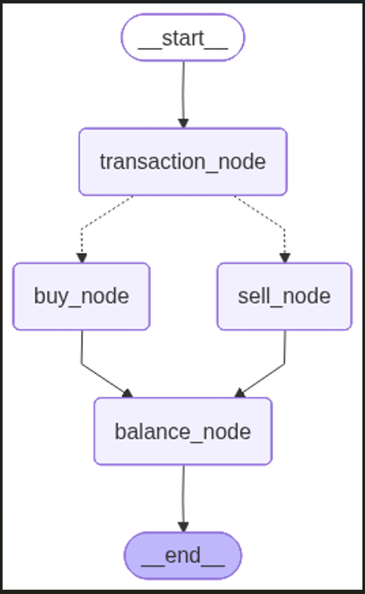
LangGraph: Key Components
The overall structure that organizes nodes and edges
Graph
Step or operation in the graph – Takes an input state and produces an output state
Node
Edge
Connects two nodes and decides how information flows through them
Data structure that describes the information flowing through the graph at each stage
Final balance
State

Slide 58
First LangGraph Application (3_1_langgraph_basic.py)
Class / Constant | Description
StateGraph | The main class for building graphs in LangGraph
START / END | Special constants representing entry and exit points of the graph
ChatOpenAI | The OpenAI integration from LangChain, used for connecting language models
TypedDict | Used to define the structure and types of data that flows through the graph
from langgraph.graph import StateGraph, START, END
from langchain_openai import ChatOpenAI
from typing import TypedDict
LangGraph uses a state-based architecture. Instead of passing data between individual nodes, all data flows through a shared "state" object. Think of it like a shared clipboard that each step can read from and write to.
user_name: Stores the user's name
greeting: Stores the generated greeting message
messages: Keeps a log of the conversation
class GraphState(TypedDict):
user_name: str
greeting: str
messages: list

Slide 59
First LangGraph Application (3_1_langgraph_basic.py)
def ask_name_node(state: GraphState) -> GraphState:
user_input = input("Bot: What is your name? ")
return {
**state,
"user_name": user_input,
"messages": state.get("messages", []) + [f"User provided name: {user_input}"]
}
Node function 1
Takes the current state as input
Asks user for their name
Returns a new state with updated information
**state copies all existing state data
Updates specific fields (user_name, messages)
def greet_user_node(state: GraphState) -> GraphState:
user_name = state.get("user_name", "there")
greeting = f"Hello {user_name}! Nice to meet you."
return {
**state,
"greeting": greeting,
"messages": state.get("messages", []) + [f"Bot: {greeting}"]
}
Node function 2
Reads user_name from the current state
Creates a personalized greeting
Updates state with the greeting and conversation log

Slide 60
First LangGraph Application (3_1_langgraph_basic.py)
def create_greeting_graph():
workflow = StateGraph(GraphState)
# Add nodes
workflow.add_node("ask_name", ask_name_node)
workflow.add_node("greet_user", greet_user_node)
# Add edges
workflow.add_edge(START, "ask_name")
workflow.add_edge("ask_name", "greet_user")
workflow.add_edge("greet_user", END)
return workflow.compile()
Graph Construction
Structure: START → ask_name → greet_user → END
Nodes represent processing steps (functions)
Edges define the flow between steps
START is where execution begins
END is where execution terminates
.compile() creates the executable graph

Slide 61
First LangGraph Application (3_1_langgraph_basic.py)
# Create the graph
app = create_greeting_graph()
# Initialize state
initial_state = GraphState(
user_name="",
greeting="",
messages=[]
)
# Run the graph
final_state = app.invoke(initial_state)
Execution
Initialize: Create empty state
Invoke: Start execution at START node
Flow: State passes through: ask_name → greet_user
Result: Get final state with all accumulated data

Slide 62
LangGraph Reducer (3_2_langgraph_without_reducer.py, 3_3_langgraph_without_reducer.py)
Reducer: Defines how state values are merged when multiple nodes write to the same key
Answers the question: “When many agents update the same state, how do we combine it?”
With reducer
def add_messages(old: List[str], new: List[str]) -> List[str]:
return old + new # This is the reducer function
class State(TypedDict):
messages: Annotated[List[str], add_messages]
def agent_a(state: State):
return {"messages": ["Hello from Agent A"]} # Not lost
def agent_b(state: State):
return {"messages": ["Hello from Agent B"]}
Without reducer
class State(TypedDict):
messages: List[str]
def agent_a(state: State):
return {"messages": ["Hello from Agent A"]}
def agent_b(state: State):
return {"messages": ["Hello from Agent B"]}

Slide 63
Using Reducer with LLM
Check the product return policy of two e-commerce websites
Use a reducer to combine the outputs of the two
Create two agents and run them in parallel
Code: 3_4_langgraph_reducer_return_policy.py

Slide 64
Looping in LangGraph (3_5_langgraph_loop.py)
Loop: A node can run more than once, based on state
class AgentState(TypedDict):
question: str
answer: str
history: List[str]
iterations: int
decision: str # "continue" or "stop"
Nodes to run in sequence:
answer
evaluate
Then a conditional edge
builder.add_conditional_edges(
"evaluate",
should_continue,
{
"continue": "answer", # LOOP
"stop": END # EXIT
}
)
Node = answer
Send question and previous answer(s) to LLM
Improve answer if needed
Increase iteration count by 1
Node = evaluate
Send question and latest answer to LLM
Ask if continue or stop and return the decision
Conditional logic in function should_continue()
If iteration count >= 3 then stop
Otherwise return the decision as it is
Main logic
Call the “answer” node and get the latest/refined answer for the question from LLM
Using “evaluate” node, pass this on to LLM and ask, more iterations needed? It will return decision as “continue” or “stop”
Take this to the “should_continue()” function and check if iteration count has exceeded 3, in which case decision = “stop”
Return the decision, which will either cause it to loop back to answer or stop

Slide 65
LangGraph Looping Patterns
Pattern | State Fields Used | Who Updates State | Stop Condition | Typical Use Case
Fixed iteration loop | iterations: int | Worker node | iterations >= N | Bounded retries, safe guard
LLM-decided loop | decision: str | Evaluator LLM | decision == "stop" | Self-refining answers
Hybrid loop (LLM + counter) | iterations, decision | Worker + Evaluator | Either condition met | Production-safe self-critique
Quality-threshold loop | score: float | Scoring node | score >= threshold | RAG answer validation
Tool-retry loop | tool_attempts: int | Tool node | tool_attempts >= max | Unreliable API calls
Budget-aware loop | tokens_used: int | LLM node | Budget exceeded | Cost-controlled agents
Memory-driven loop | history: list | Any node | No new info added | Reasoning saturation
Event-driven loop | events: list | External input | Event resolved | Human-in-the-loop
Error-recovery loop | error_count: int | Exception handler | Errors exceed limit | Robust pipelines
Multi-agent consensus loop | votes: dict | Parallel agents | Consensus reached | Agent debates

Slide 66
Human Control and Override Workflows
Human control workflow: The graph pauses, escalates, or reroutes based on human input instead of continuing autonomously
Humans do not interrupt nodes – They change the state
Implementation
class AgentState(TypedDict):
task: str
result: str
status: str # auto | needs_review | approved | rejected
human_feedback: str

Slide 67
Human In The Loop (HITL) Pattern
Step 1: Agent reaches some uncertainty
def agent_node(state):
if "maybe" in state["result"]:
return {"status": "needs_review"}
return {"status": "auto"}
Step 2: Conditional edge pauses or escalates
def route(state):
if state["status"] == "needs_review":
return "human"
return "end"

Slide 68
Human In The Loop (HITL) Pattern
Step 3: Human node waits for input
def human_review_node(state):
# In practice: UI, API, webhook, Slack, n8n, etc.
return {
"human_feedback": "Approved with changes",
"status": "approved"
}
Step 4: Graph resumes based on human decision
def post_review_route(state):
return state["status"] # approved / rejected
Code: 3_6_langgraph_hitl.py

Slide 69
Useful LangGraph Concepts
Using external APIs: 3_7_langgraph_news_summarizer.py
Banking chatbot using Gradio: 3_8_langgraph_bank_ntfy_email.py

